Slide 1

Note: The data and information in this document is reflective of a hypothetical situation and client. This document is to be used for KPMG Virtual Internship purposes only.
Sprocket Central Pty Ltd
Data analytics approach
[Division Name] - [Engagement Manager], [Senior Consultant], [Junior Consultant]

Slide 2
Note: The data and information in this document is reflective of a hypothetical situation and client. This document is to be used for KPMG Virtual Internship purposes only.
Agenda
Introduction
Data Exploration
Model Development
Interpretation

Slide 3
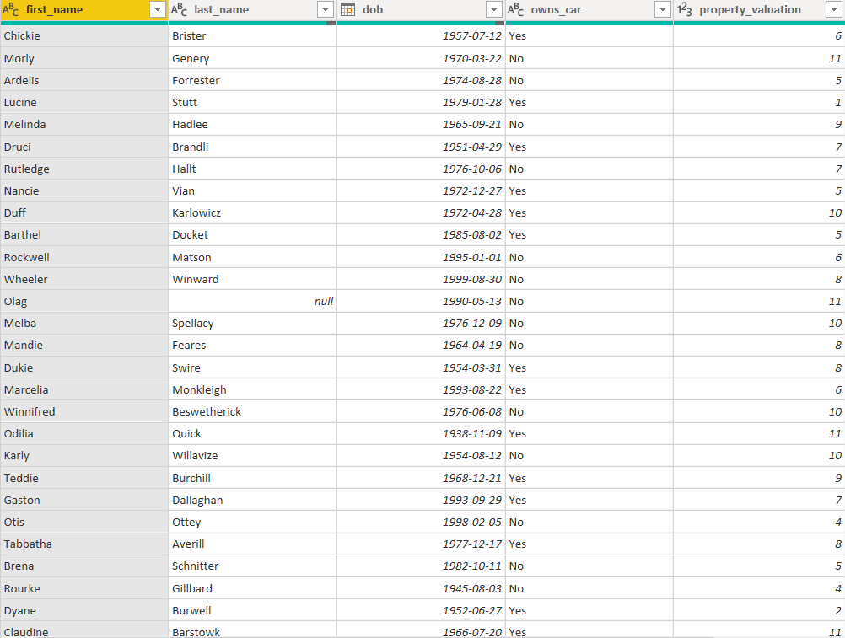
Note: The data and information in this document is reflective of a hypothetical situation and client. This document is to be used for KPMG Virtual Internship purposes only.
Introduction
Who to target to drive the most value for the organization?

Slide 4
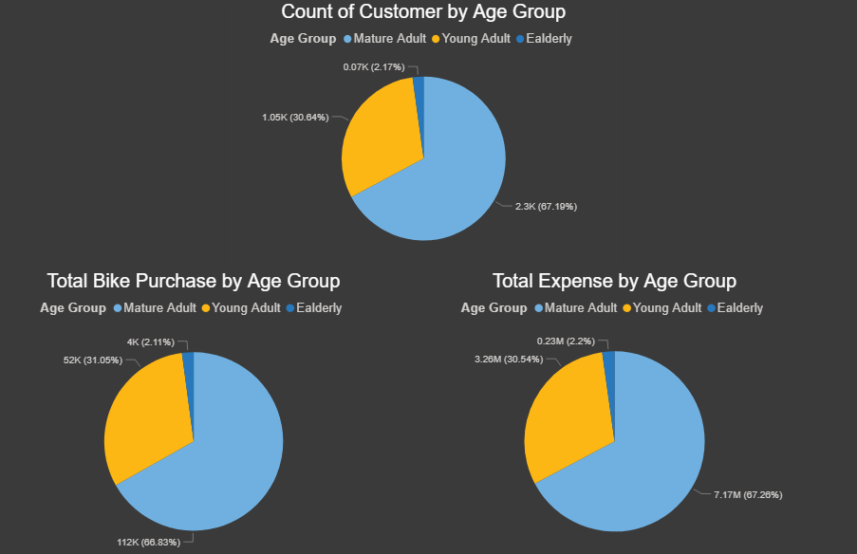
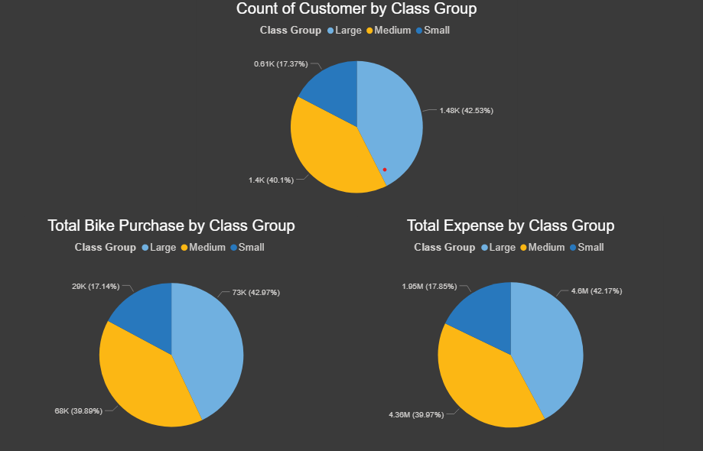
Note: The data and information in this document is reflective of a hypothetical situation and client. This document is to be used for KPMG Virtual Internship purposes only.
Data Exploration
Mature adult (35 - 65) has the most proportion – 67.91%
Large property (8 - 12) has the most proportion – 42.17%

Slide 5
Note: The data and information in this document is reflective of a hypothetical situation and client. This document is to be used for KPMG Virtual Internship purposes only.
Model Development
Focus more on consumers aging from 35 – 65 with large property

Slide 6
Note: The data and information in this document is reflective of a hypothetical situation and client. This document is to be used for KPMG Virtual Internship purposes only.
Interpretation
In conclusion, target for mature adult with large property

